Slide 1
UCT places people at the center stage
Unleash human potential towards a fair and just society

Slide 2
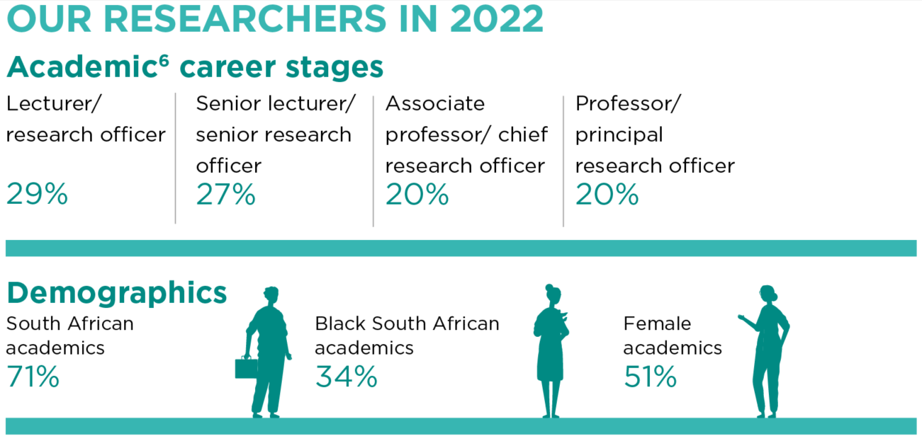
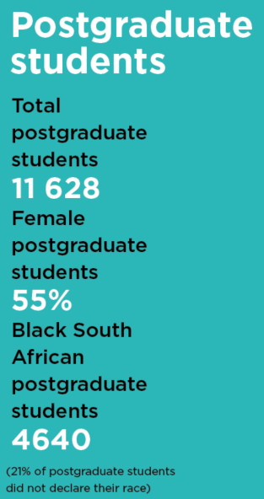
Notes:
Extra info PG 53% female. Need % black & number PhD

Slide 3
Our key priorities
Attract & keep key researchers
Top academics
Next generation leaders
Academic career paths
Both soft-funded & GOB
Increased recognition of SFARS
Increase research active staff
Enhance PDRF experience @UCT
Enhance PG student experience and success
Excellence, Transformation, Sustainability
Notes:
to grow UCT’s research-active staff. UCT brands itself as research active;
yet many of our staff, largely constrained by time or funding, still need to develop their research portfolios to ones of substance. The importance of the
concomitant development of teaching and learning and research profiles is key. This
requires us to tackle workload, particularly that of early career researchers.

Slide 4
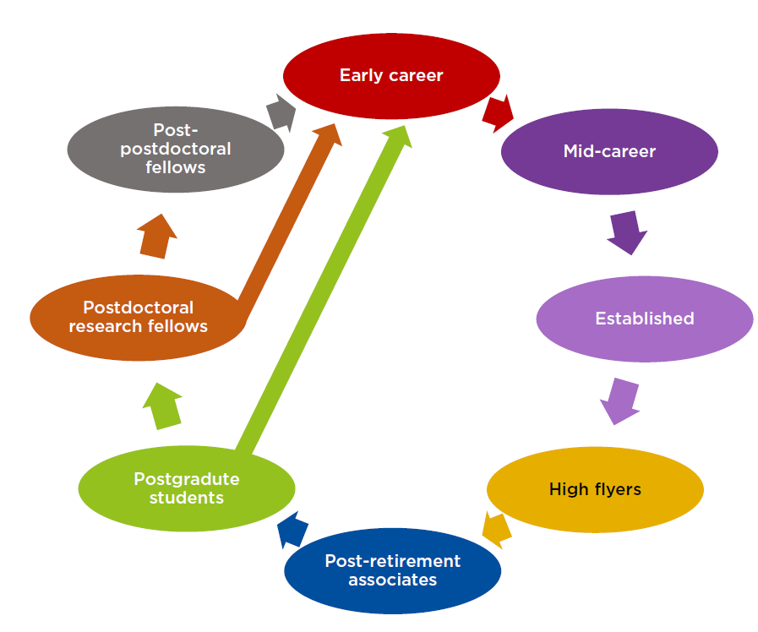
Future professors
Building research active academic staff
Next gen professorate
Emerging researcher programme
Enabling Grant Seeker Excellence awards
Wellcome fellows
HUGS – helping academic staff in grant seeking
Black Academic Advancement Programme (BAAP)
Research Leadership Programme
URC Junior Research fellows (JRF)
Carnegie JRFs, PDRFs & PhDs
International grants
nGap
Accelerated Transformation of Academic Project ATAP
Grand Challenges prog & pilots
SARChI Chair programme
SDG postdocs
Industry-linked postdocs – in progress
Research investment proposal – work in progress
PI-funded postdocs
Senior research scholars
URC postdocs
NRF postdocs
Emeritus professors

Slide 5
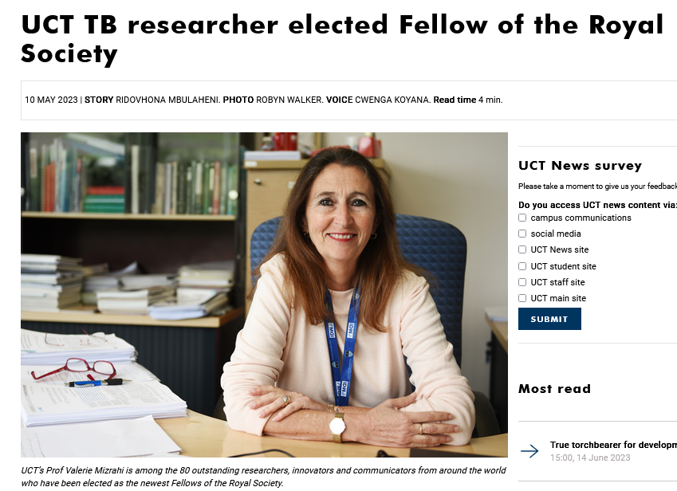
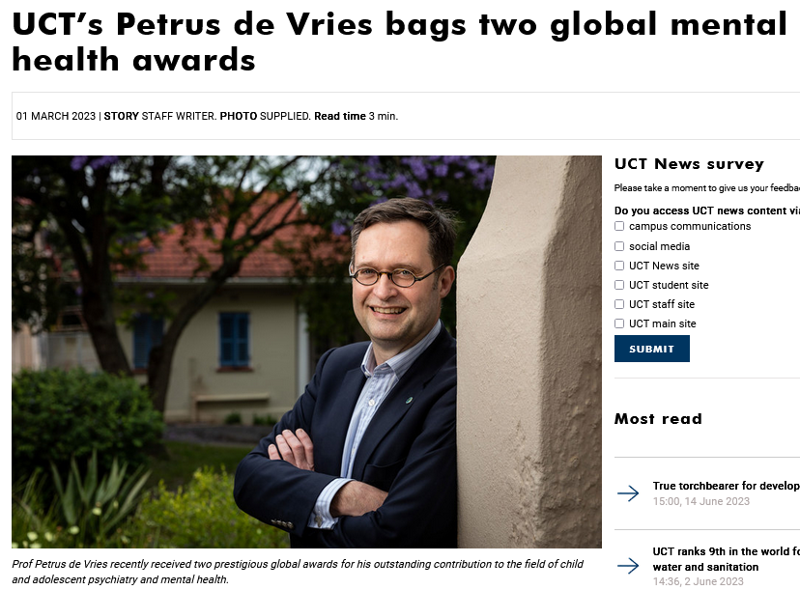
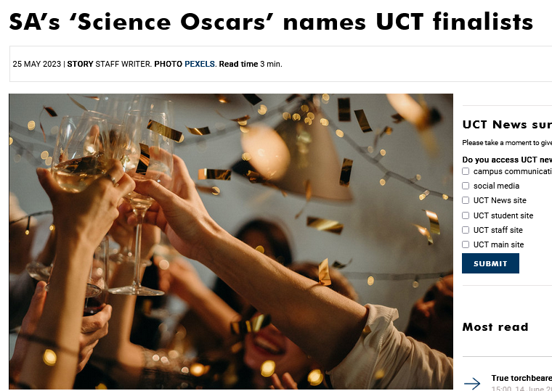
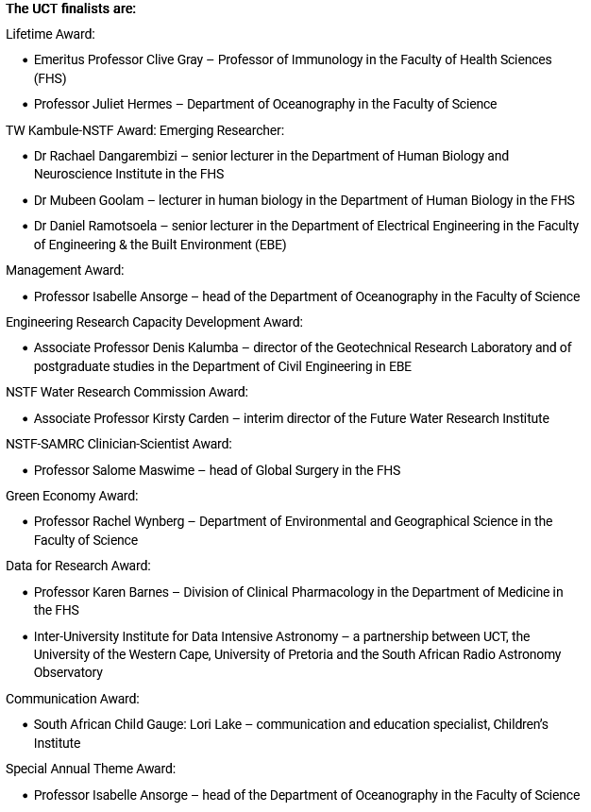
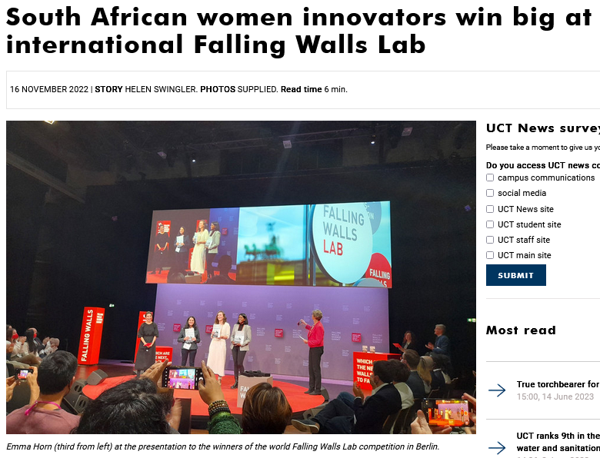
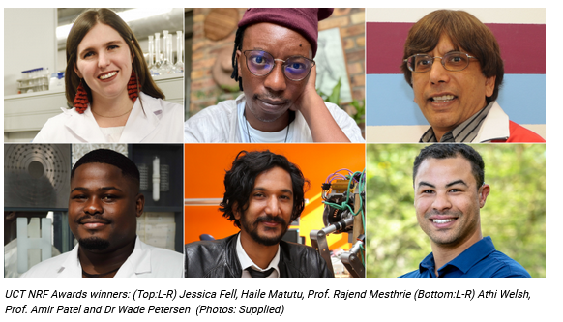
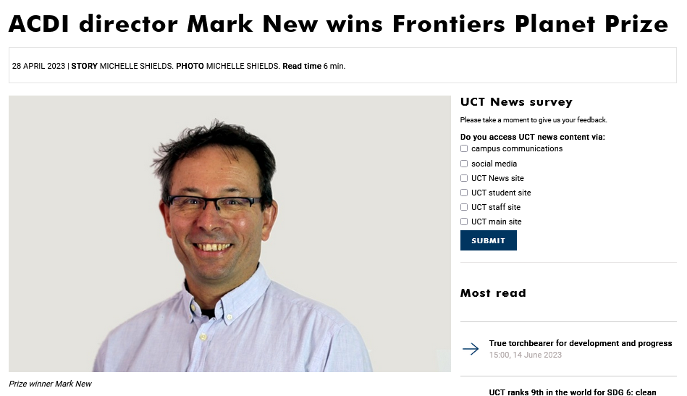
Some of our successes…
THANK YOU

Slide 6
Looking forward…
Induction packs for new academics on research support
Diversify research funding streams
Enhance and integrate research support
Stimulate research-linked innovation & entrepreneurship
Enhance the postdoctoral research fellows’ experience
Recognise needs of researchers across their career path journey
Actively build the next generation of highly productive researchers
Improve recognition of the soft-funded research enterprise
Build academics with a T&L / research balance
Enhance opportunities for postdoctoral fellows
Enhance the PhD experience
Notes:
Implementation of SFARS policy
Research career pathing
Workload model

